Slide 1
Manicure
Shawna Tuli (shawna.tuli@avanade.com)
Northern California Wellness

Slide 2
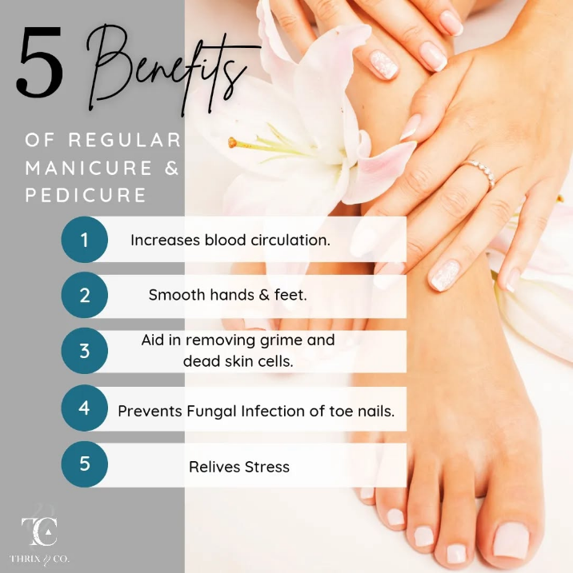
5 Benefits of Regular Manicure & Pedicure

Slide 3
Benefits of Manicures
Improved Nail Health
Regular manicures help maintain healthy nails by keeping them clean, trimmed, and free from dirt and bacteria, which reduces the risk of infections.
Enhanced Appearance
Manicures contribute to a groomed and polished look, making hands and nails look more attractive and well-maintained.
Increased Confidence
Having well-manicured nails can boost self-esteem and confidence, making individuals feel more put-together.
Relaxation
Manicures often include a hand massage, which can help relax muscles, improve blood circulation, and reduce stress.
Exfoliation
Some manicures include exfoliation, which helps remove dead skin cells and promotes new cell growth, leaving hands feeling softer and smoother.
Hydration
Manicures often involve moisturizing the hands and nails, helping to prevent dryness and maintain hydration.

